Slide 1
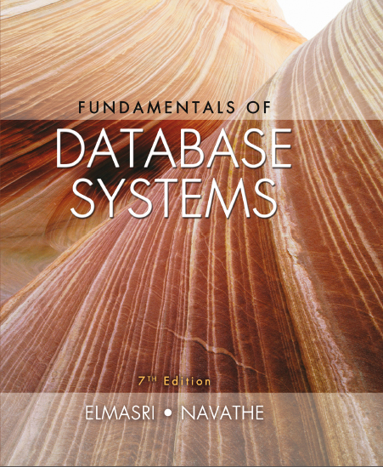
Fundamentals of Database Systems
Seventh Edition
Chapter 7
More S Q L: Complex Queries, Triggers, Views, and Schema Modification
Copyright © 2016, 2011, 2007 Pearson Education, Inc. All Rights Reserved
Notes:
If this PowerPoint presentation contains mathematical equations, you may need to check that your computer has the following installed:
1) MathType Plugin
2) Math Player (free versions available)
3) NVDA Reader (free versions available)

Slide 2
Learning Objectives
7.1 More Complex S Q L Retrieval Queries
7.2 Specifying Semantic Constraints as Assertions and Actions as Triggers
7.3 Views (Virtual Tables) in S Q L
7.4 Schema Modification in S Q L

Slide 3
More Complex S Q L Retrieval Queries
Additional features allow users to specify more complex retrievals from database:
Nested queries, joined tables, and outer joins (in the FROM clause), aggregate functions, and grouping

Slide 4
Comparisons Involving NULL and Three-Valued Logic (1 of 3)
Meanings of NULL
Unknown value
Unavailable or withheld value
Not applicable attribute
Each individual NULL value considered to be different from every other NULL value
S Q L uses a three-valued logic:
TRUE, FALSE,and UNKNOWN (like Maybe)
NULL = NULL comparison is avoided

Slide 5
Comparisons Involving NULL and Three-Valued Logic (2 of 3)
Table 7.1 Logical Connectives in Three-Valued Logic
(a) | AND | TRUE | FALSE | UNKNOWN
Blank | TRUE | TRUE | FALSE | UNKNOWN
Blank | FALSE | FALSE | FALSE | FALSE
Blank | UNKNOWN | UNKNOWN | FALSE | UNKNOWN
(b) | OR | TRUE | FALSE | UNKNOWN
Blank | TRUE | TRUE | TRUE | TRUE
Blank | FALSE | TRUE | FALSE | UNKNOWN
Blank | UNKNOWN | TRUE | UNKNOWN | UNKNOWN
(C) | NOT | Blank | Blank | Blank
Blank | TRUE | FALSE | Blank | Blank
Blank | FALSE | TRUE | Blank | Blank
Blank | UNKNOWN | UNKNOWN | Blank | Blank

Slide 6

Comparisons Involving NULL and Three-Valued Logic (3 of 3)
S Q L allows queries that check whether an attribute value is NULL
I S or I S NOT NULL
Query 18. Retrieve the names of all employees who do not have supervisors.

Slide 7
Nested Queries, Tuples, and Set/Multiset Comparisons
Nested queries
Complete select-from-where blocks within WHERE clause of another query
Outer query and nested subqueries
Comparison operator IN
Compares value v with a set (or multiset) of values V
Evaluates to TRUE if v is one of the elements in V

Slide 8
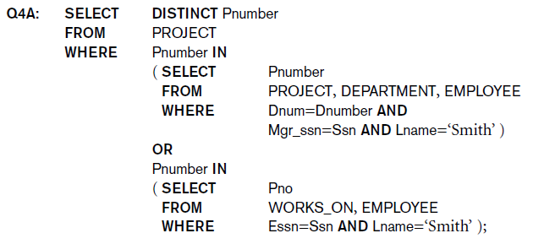
Nested Queries (1 of 4)

Slide 9
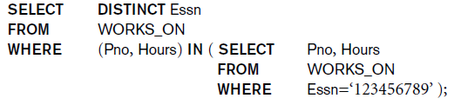
Nested Queries (2 of 4)
Use tuples of values in comparisons
Place them within parentheses

Slide 10
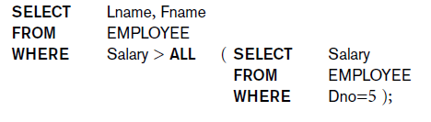
Nested Queries (3 of 4)
Use other comparison operators to compare a single value v
= ANY (or = SOME) operator
Returns TRUE if the value v is equal to some value in the set V and is hence equivalent to IN
Other operators that can be combined with ANY (or SOME):
ALL: value must exceed all values from nested query

Slide 11
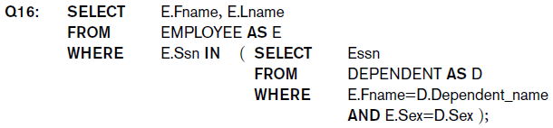
Nested Queries (4 of 4)
Avoid potential errors and ambiguities
Create tuple variables (aliases) for all tables referenced in S Q L query
Query 16. Retrieve the name of each employee who has a dependent with the same first name and is the same sex as the employee.

Slide 12
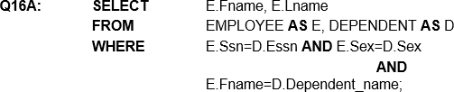
Correlated Nested Queries
Queries that are nested using the = or IN comparison operator can be collapsed into one single block: E.g., Q16 can be written as:
Correlated nested query
Evaluated once for each tuple in the outer query

Slide 13
The EXISTS and UNIQUE Functions in S Q L for Correlating Queries
EXISTS function
Check whether the result of a correlated nested query is empty or not. They are Boolean functions that return a TRUE or FALSE result.
EXISTS and NOT EXISTS
Typically used in conjunction with a correlated nested query
S Q L function UNIQUE( Q)
Returns True if there are no duplicate tuples in the result of query Q

Slide 14
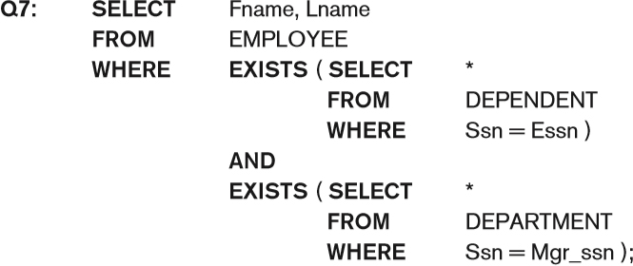
USE of EXISTS

Slide 15
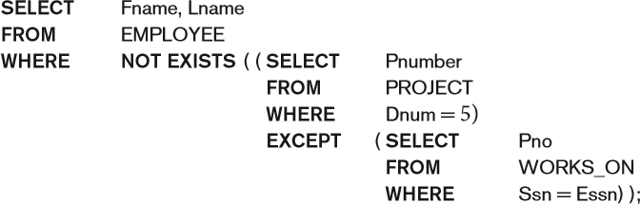
USE OF NOT EXISTS
To achieve the “for all” (universal quantifier- see Chapter 8) effect, we use double negation this way in S Q L:
Query: List first and last name of employees who work on ALL projects controlled by D n o=5.
The above is equivalent to double negation: List names of those employees for whom there does NOT exist a project managed by department n o. 5 that they do NOT work on.

Slide 16
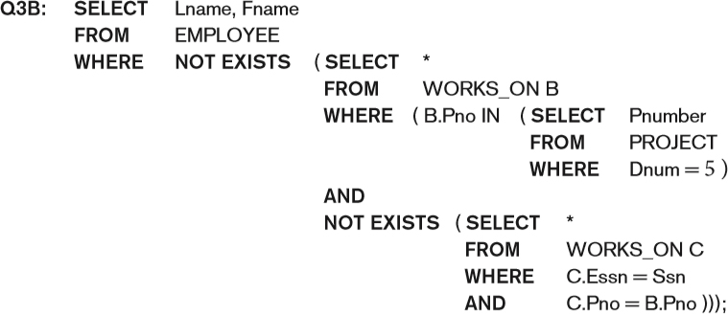
Double Negation to Accomplish “for All” in S Q L
The above is a direct rendering of: List names of those employees for whom there does Not exist a project managed by department n o. 5 that they do Not work on.

Slide 17


Explicit Sets and Renaming of Attributes in S Q L
Can use explicit set of values in WHERE clause
Use qualifier AS followed by desired new name
Rename any attribute that appears in the result of a query

Slide 18

Specifying Joined Tables in the FROM Clause of S Q L
Joined table
Permits users to specify a table resulting from a join operation in the FROM clause of a query
The FROM clause in Q1A
Contains a single joined table. JOIN may also be called INNER JOIN

Slide 19
Different Types of JOINed Tables in S Q L
Specify different types of join
NATURAL JOIN
Various types of OUTER JOIN (LEFT, RIGHT, FULL)
NATURAL JOIN on two relations R and S
No join condition specified
Is equivalent to an implicit EQUIJOIN condition for each pair of attributes with same name from R and S

Slide 20

NATURAL JOIN
Rename attributes of one relation so it can be joined with another using NATURAL JOIN:
The above works with EMPLOYEE.D n o = DEPT.D n o as an implicit join condition

Slide 21
INNER and OUTER Joins
INNER JOIN (versus OUTER JOIN)
Default type of join in a joined table
Tuple is included in the result only if a matching tuple exists in the other relation
LEFT OUTER JOIN
Every tuple in left table must appear in result
If no matching tuple
Padded with NULL values for attributes of right table
RIGHT OUTER JOIN
Every tuple in right table must appear in result
If no matching tuple
Padded with NULL values for attributes of left table

Slide 22


Example: LEFT OUTER JOIN
Alternate Syntax:

Slide 23
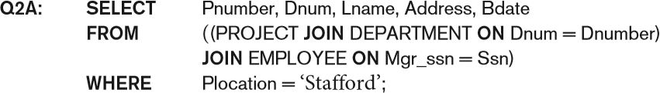
Multiway JOIN in the FROM Clause
FULL OUTER JOIN – combines result if LEFT and RIGHT OUTER JOIN
Can nest JOIN specifications for a multiway join:

Slide 24
Aggregate Functions in S Q L (1 of 3)
Used to summarize information from multiple tuples into a single-tuple summary
Built-in aggregate functions
COUNT, SUM, MAX, MIN,and AVG
Grouping
Create subgroups of tuples before summarizing
To select entire groups, HAVING clause is used
Aggregate functions can be used in the SELECT clause or in a HAVING clause

Slide 25

Renaming Results of Aggregation
Following query returns a single row of computed values from EMPLOYEE table:
The result can be presented with new names:

Slide 26
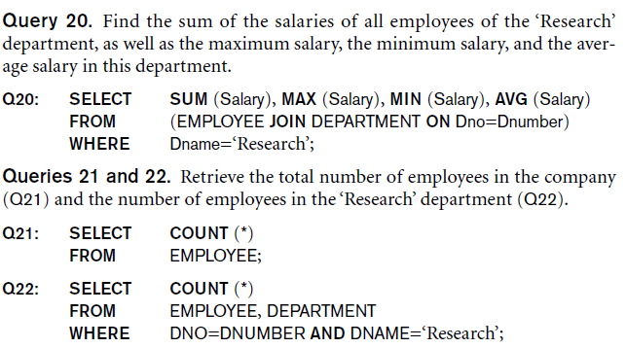
Aggregate Functions in S Q L (2 of 3)
NULL values are discarded when aggregate functions are applied to a particular column
Query 20. Find the sum of the salaries of all employees of the ‘Research’ department, as well as the maximum salary, the minimum salary, and the average salary in this department.
Queries 21 and 22. Retrieve the total number of employees in the company (Q21) and the number of employees in the ‘Research’ department (Q22).

Slide 27
Aggregate Functions in S Q L (3 of 3)

Slide 28
Aggregate Functions on Booleans
SOME and ALL may be applied as functions on Boolean Values.
SOME returns true if at least one element in the collection is TRUE (similar to OR)
ALL returns true if all of the elements in the collection are TRUE (similar to AND)

Slide 29
Grouping: The GROUP BY Clause
Partition relation into subsets of tuples
Based on grouping attribute(s)
Apply function to each such group independently
GROUP BY clause
Specifies grouping attributes
COUNT (*) counts the number of rows in the group

Slide 30

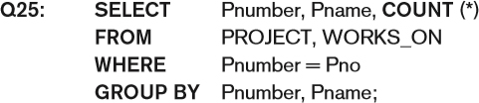
Examples of GROUP BY
The grouping attribute must appear in the SELECT clause:
If the grouping attribute has NULL as a possible value, then a separate group is created for the null value (e.g., null D n o in the above query)
GROUP BY may be applied to the result of a JOIN:

Slide 31
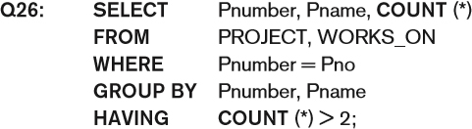
Grouping: The GROUP BY and HAVING Clauses
HAVING clause
Provides a condition to select or reject an entire group:
Query 26. For each project on which more than two employees work, retrieve the project number, the project name, and the number of employees who work on the project.

Slide 32
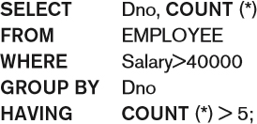
Combining the WHERE and the HAVING Clause (1 of 2)
Consider the query: we want to count the total number of employees whose salaries exceed $40,000 in each department, but only for departments where more than five employees work.
Incorrect Query:

Slide 33
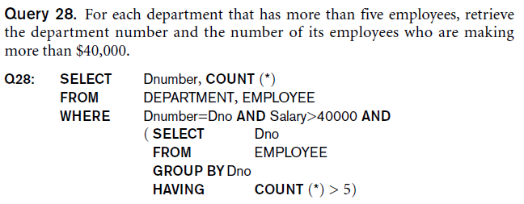
Combining the WHERE and the HAVING Clause (2 of 2)
Correct Specification of the Query:
Note: the WHERE clause applies tuple by tuple whereas HAVING applies to entire group of tuples
Query 28. For each department that has more than five employees, retrieve the department number and the number of its employees who are making more than $40,000.

Slide 34
Use of WITH
The WITH clause allows a user to define a table that will only be used in a particular query (not available in all S Q L implementations)
Used for convenience to create a temporary “View” and use that immediately in a query
Allows a more straightforward way of looking a step-by-step query

Slide 35
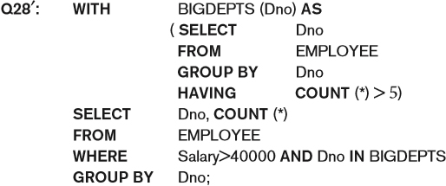
Example of WITH
See an alternate approach to doing Q28:

Slide 36
Use of CASE
S Q L also has a CASE construct
Used when a value can be different based on certain conditions.
Can be used in any part of an S Q L query where a value is expected
Applicable when querying, inserting or updating tuples

Slide 37
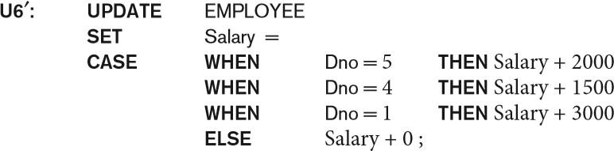
EXAMPLE of Use of CASE
The following example shows that employees are receiving different raises in different departments (A variation of the update U6)

Slide 38
Recursive Queries in S Q L
An example of a recursive relationship between tuples of the same type is the relationship between an employee and a supervisor.
This relationship is described by the foreign key Super_ssn of the EMPLOYEE relation
An example of a recursive operation is to retrieve all supervisees of a supervisory employee e at all levels—that is, all employees e’ directly supervised by e, all employees e’ directly supervised by each employee e’, all employees e”’ directly supervised by each employee e”, and so on. Thus the C E O would have each employee in the company as a supervisee in the resulting table. Example shows such table SUP_E M P with 2 columns (Supervisor,Supervisee(any level)):

Slide 39
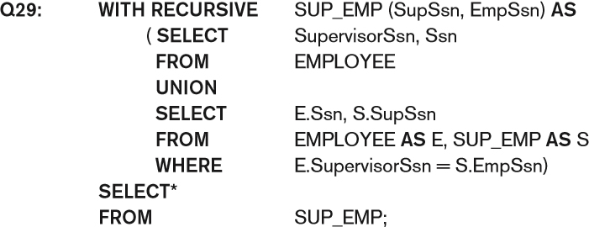
An EXAMPLE of RECURSIVE Query
The above query starts with an empty SUP_E M P and successively builds SUP_E M P table by computing immediate supervisees first, then second level supervisees, etc. until a fixed point is reached and no more supervisees can be added

Slide 40
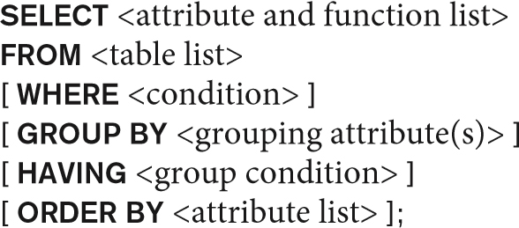
EXPANDED Block Structure of S Q L Queries

Slide 41
Specifying Constraints as Assertions and Actions as Triggers
Semantic Constraints: The following are beyond the scope of the E E R and relational model
CREATE ASSERTION
Specify additional types of constraints outside scope of built-in relational model constraints
CREATE TRIGGER
Specify automatic actions that database system will perform when certain events and conditions occur

Slide 42
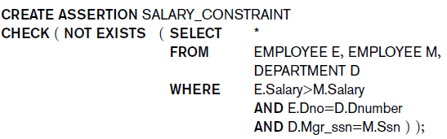
Specifying General Constraints as Assertions in S Q L
CREATE ASSERTION
Specify a query that selects any tuples that violate the desired condition
Use only in cases where it goes beyond a simple CHECK which applies to individual attributes and domains

Slide 43
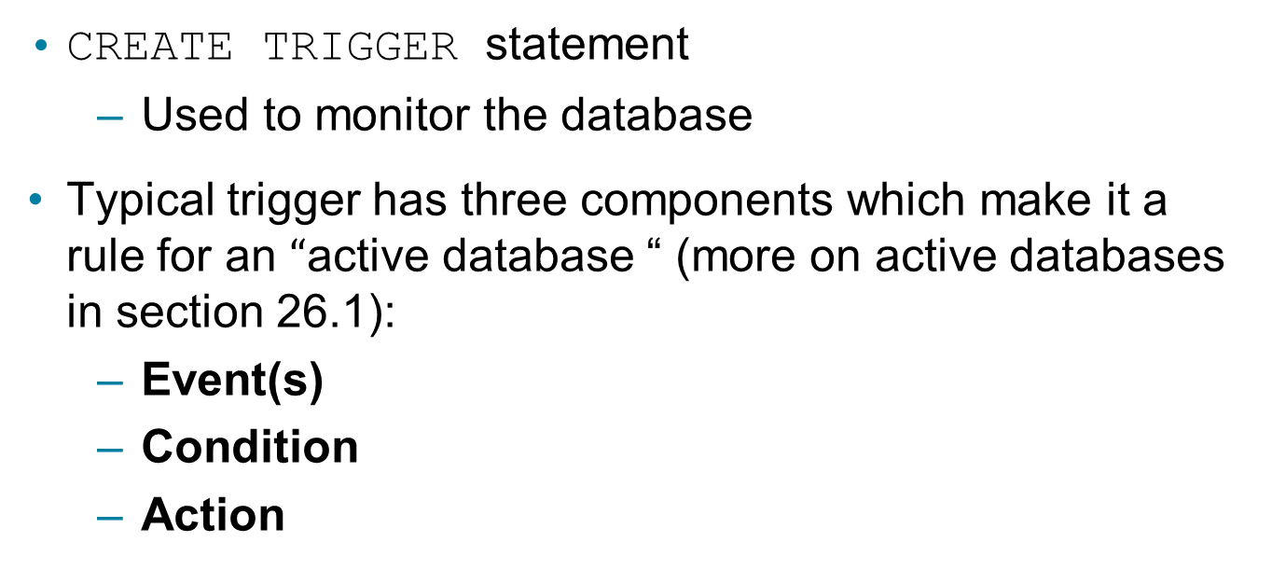
Introduction to Triggers in S Q L
CREATE TRIGGER statement
Used to monitor the database
Typical trigger has three components which make it a rule for an $“$active database “ (more on active databases in section 26.1):
Event(s)
Condition
Action

Slide 44
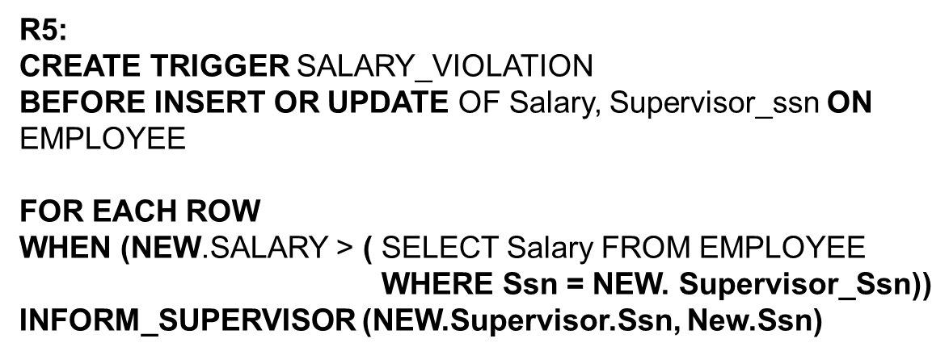
Use of TRIGGERS
An EXAMPLE with standard Syntax.(Note : other S Q L implementations like PostgreSQL use a different syntax.)

Slide 45
Views (Virtual Tables) in S Q L
Concept of a view in S Q L
Single table derived from other tables called the defining tables
Considered to be a virtual table that is not necessarily populated

Slide 46
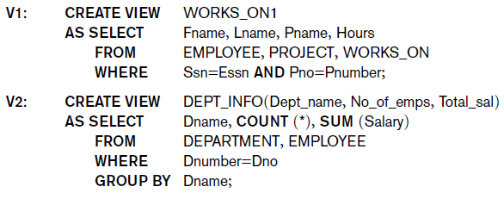
Specification of Views in S Q L (1 of 2)
CREATE VIEW command
Give table name, list of attribute names, and a query to specify the contents of the view
In V1, attributes retain the names from base tables. In V2, attributes are assigned names

Slide 47
Specification of Views in S Q L (2 of 2)
Once a View is defined, S Q L queries can use the View relation in the FROM clause
View is always up-to-date
Responsibility of the D B M S and not the user
DROP VIEW command
Dispose of a view

Slide 48
View Implementation, View Update, and Inline Views
Complex problem of efficiently implementing a view for querying
Strategy1: Query modification approach
Compute the view as and when needed. Do not store permanently
Modify view query into a query on underlying base tables
Disadvantage: inefficient for views defined via complex queries that are time-consuming to execute

Slide 49
View Materialization (1 of 2)
Strategy 2: View materialization
Physically create a temporary view table when the view is first queried
Keep that table on the assumption that other queries on the view will follow
Requires efficient strategy for automatically updating the view table when the base tables are updated
Incremental update strategy for materialized views
D B M S determines what new tuples must be inserted, deleted, or modified in a materialized view table

Slide 50
View Materialization (2 of 2)
Multiple ways to handle materialization:
immediate update strategy updates a view as soon as the base tables are changed
lazy update strategy updates the view when needed by a view query
periodic update strategy updates the view periodically (in the latter strategy, a view query may get a result that is not up-to-date). This is commonly used in Banks, Retail store operations, etc.

Slide 51

View Update
Update on a view defined on a single table without any aggregate functions
Can be mapped to an update on underlying base table- possible if the primary key is preserved in the view
Update not permitted on aggregate views. E.g.,
cannot be processed because Total_s a l is a computed value in the view definition

Slide 52
View Update and Inline Views
View involving joins
Often not possible for D B M S to determine which of the updates is intended
Clause WITH CHECK OPTION
Must be added at the end of the view definition if a view is to be updated to make sure that tuples being updated stay in the view
In-line view
Defined in the FROM clause of an S Q L query (e.g., we saw its used in the WITH example)

Slide 53

Views as Authorization Mechanism
S Q L query authorization statements (GRANT and REVOKE) are described in detail in Chapter 30
Views can be used to hide certain attributes or tuples from unauthorized users
E.g., For a user who is only allowed to see employee information for those who work for department 5, he may only access the view
DEPT5EMP:

Slide 54
Schema Change Statements in S Q L
Schema evolution commands
D B A may want to change the schema while the database is operational
Does not require recompilation of the database schema

Slide 55
The DROP Command
DROP command
Used to drop named schema elements, such as tables, domains, or constraint
Drop behavior options:
CASCADE and RESTRICT
Example:
DROP SCHEMA COMPANY CASCADE;
This removes the schema and all its elements including tables, views, constraints, etc.

Slide 56

The ALTER Table Command
Alter table actions include:
Adding or dropping a column (attribute)
Changing a column definition
Adding or dropping table constraints
Example:

Slide 57

Adding and Dropping Constraints
Change constraints specified on a table
Add or drop a named constraint

Slide 58
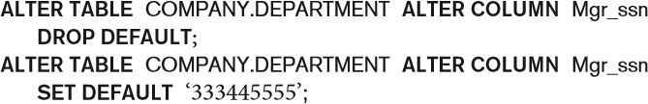
Dropping Columns, Default Values
To drop a column
Choose either CASCADE or RESTRICT
CASCADE would drop the column from views etc. RESTRICT is possible if no views refer to it.
Default values can be dropped and altered :

Slide 59
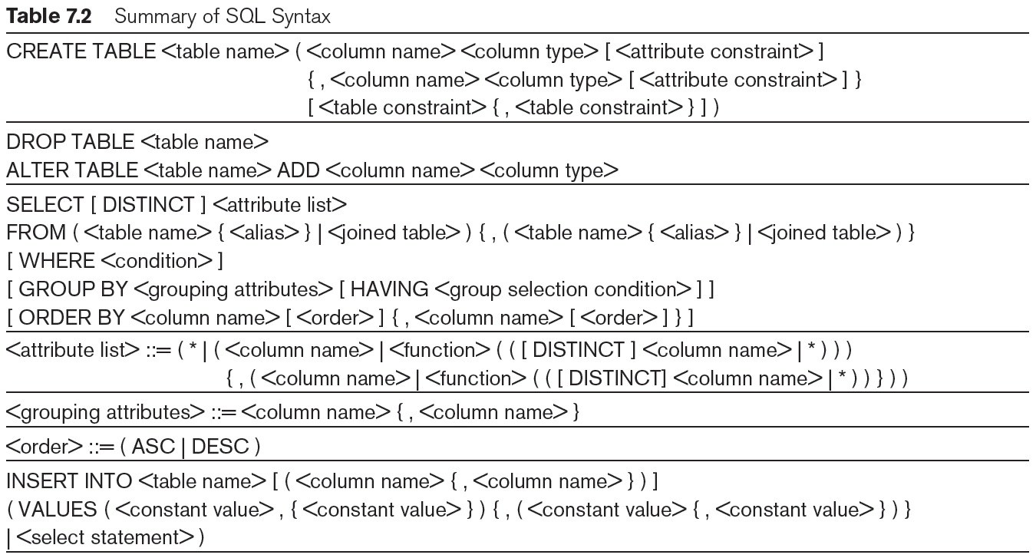
Table 7.2 Summary of S Q L Syntax (1 of 2)

Slide 60
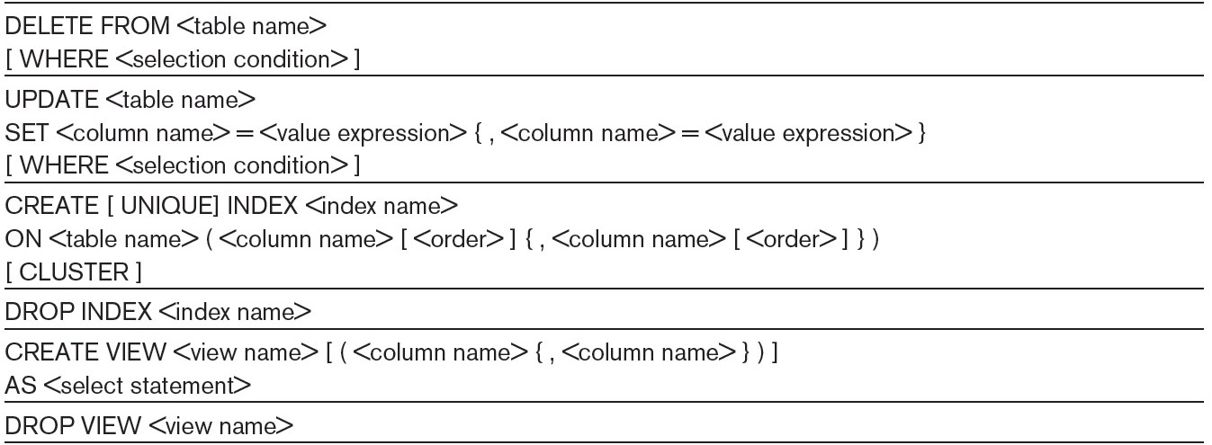
Table 7.2 Summary of S Q L Syntax (2 of 2)
Note: The commands for creating and dropping indexes are not part of standard S Q L.

Slide 61
Summary
Complex S Q L:
Nested queries, joined tables (in the FROM clause), outer joins, aggregate functions, grouping
Handling semantic constraints with CREATE ASSERTION and CREATE TRIGGER
CREATE VIEW statement and materialization strategies
Schema Modification for the D B As using ALTER TABLE, ADD AND DROP COLUMN, ALTER CONSTRAINT etc.

Slide 62

Copyright

